Slide 1


Identifying Ships from Satellite Photos CS611 MLE
Koh En Yong | Ng Ding Xuan Arnold | Quek Hao Yong, Gabriel | Wong Songhan

Slide 2

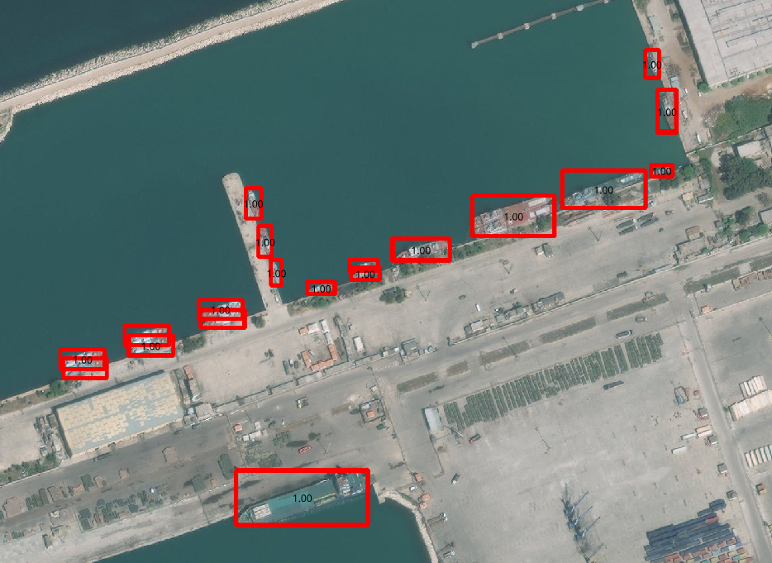


Identifying ships in satellite images has several uses in business and government
Maritime Traffic Management
Real-time automated vessel counts in transit zones can facilitate operational decision making in maritime traffic management
Maritime Surveillance & Policing
Automated vessel detection can enable surveillance of large areas to support maritime policing to prevent and deter piracy, drug trafficking, illegal cargo movement, etc.
Naval Warfare
Automated vessel detection can support review of intelligence to identify enemy locations

Slide 3

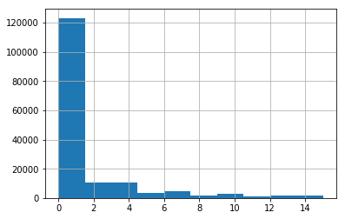
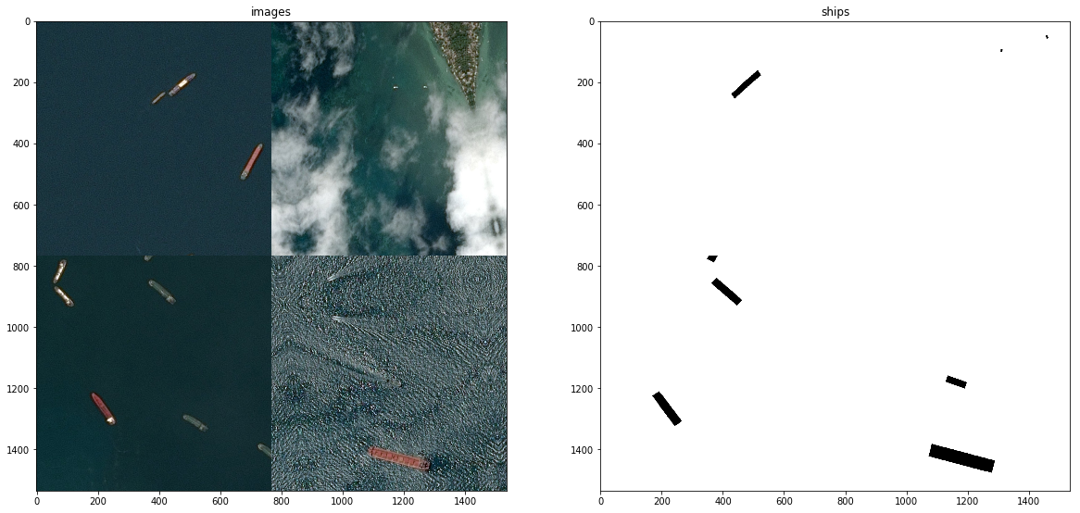
Dataset Summary
Dataset from Airbus Ship Detection Challenge¹ on
192,556 images of open sea, docks, marinas, etc.
Input data
Satellite images
Output label
Object bounding boxes
Fig 1. Histogram of no. of ships per image
¹ Dataset can be found at: https://www.kaggle.com/competitions/airbus-ship-detection
Notes:
Training and labeled dataset is based on Kaggle repository (airbus satellite imagery)

Slide 4
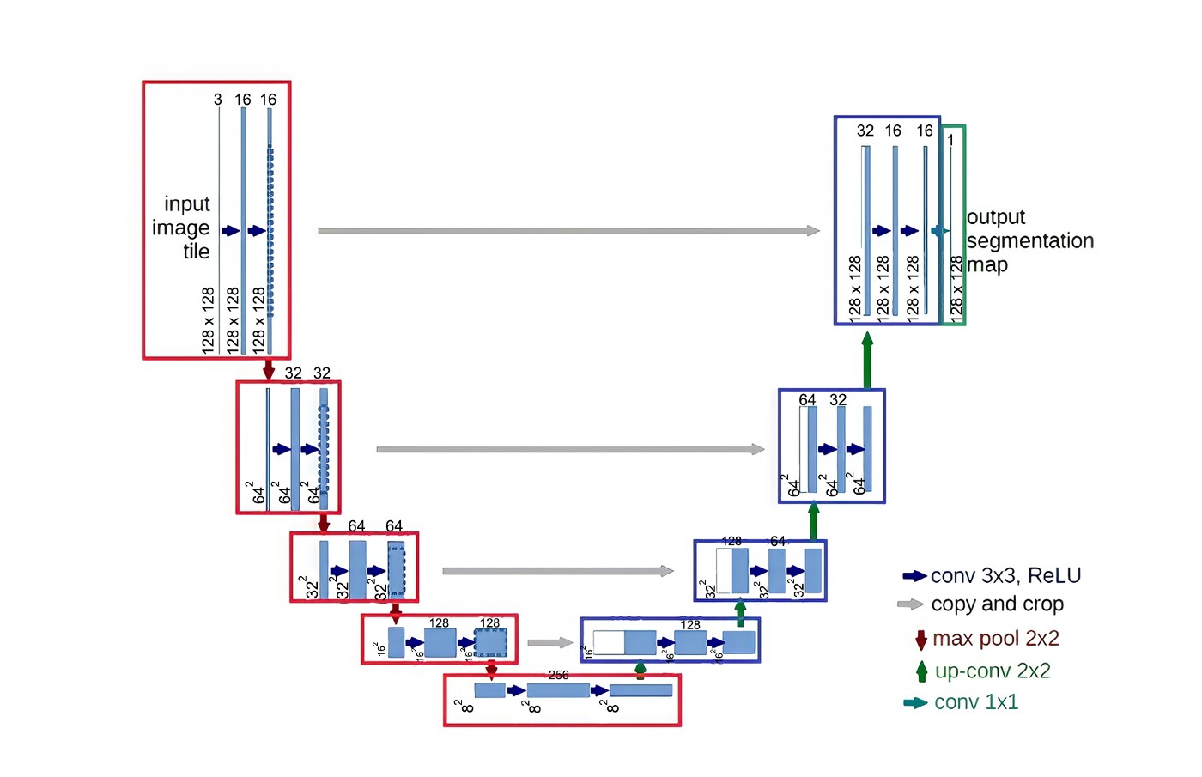
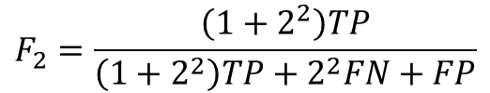

Modelling approach
Performance Measurement
Determining prediction correctness
Intersection of Union (IoU) is given by:
Ground truth
$$IoU\left(A,B\right)=\frac{A∩B}{A∪B}$$
Prediction
Different threshold can be set for calculation of ROC curve
Measuring model performance
U-Net is a deep CNN architecture which is ideal for semantic segmentation¹ in computer vision
Generates a label for each pixel which creates a mask identifying which parts of the image are ships
F2-score given by:
$$F_{2}=\frac{\left(1+2^{2}\right)TP}{\left(1+2^{2}\right)TP+2^{2}FN+FP}$$
Weight performance measurement to recall as we want to ensure a larger proportion of actual ships are captured
¹ Ronneberger, O., Fischer, P., & Brox, T. (2015, May 18). U-Net: Convolutional Networks for Biomedical Image Segmentation. arXiv.org.
Retrieved May 29, 2022, from https://arxiv.org/abs/1505.04597
Notes:
A true positive is counted when a single predicted object matches a ground truth object with an IoU above the threshold. The average F2 Score of a single image is then calculated as the mean of the above F2 Score values at each IoU threshold.

Slide 5
Machine Learning Pipeline
Training, validation, and test datasets need to be extracted from storage
Data Validation
Ensures no bugs caused by wrong or incorrectly used data
Data Preparation
Converts data into the form accepted by the model
Model Training
Model Validation & Evaluation
Ensures model produces expected output and outperforms baseline
Model Deployment
Output model as a service for consumption
Check filetype, check images are of the correct size, correct data type, values within limits (e.g. 0-255)
Normalisation of each pixel, convert to tensor
Check distribution of training and test dataset are similar
Check distribution of dataset in current pipeline run is similar to that in previous runs
Batching for faster training
Check schema of labels
Specify hyperparameters
Check validity of datatypes and values of hyperparameters
Minimum F2 score must be achieved for model to be accepted
Optionally load an existing model, if only hyperparameters are changed
Load metrics of baseline model (e.g. best performing testing model so far, or production model), and compare candidate model against baseline
Deployment strategy depends on the improvement of candidate model over production model
If improvement is marginal, canary testing could be used. If improvement is decent, A/B testing may be used. If improvement is considerable, full deployment could be used.
There will always be the option to rollback to a previous working version.
Data Extraction
Input to the entire pipeline

Slide 6







How is CI/CD planned?
vertex.ai
Repository
Cloud Build
Pipeline
Process Building
Trigger
Change in Pipeline
CI/CD routine
Clone repository.
Unit tests.
End-to-End pipeline test.
Build container image.
Compile pipeline.
Upload the pipeline.
Container
Registry
Notes:
Dataset management and annotation
Model Training
Etc..
If time permits, the CI/CD routine consists of
Cloning repo to build environment
Unit testing
End-to-end pipeline testing
Building ML container image
Compiling pipeline
Uploading pipeline to cloud

Slide 7
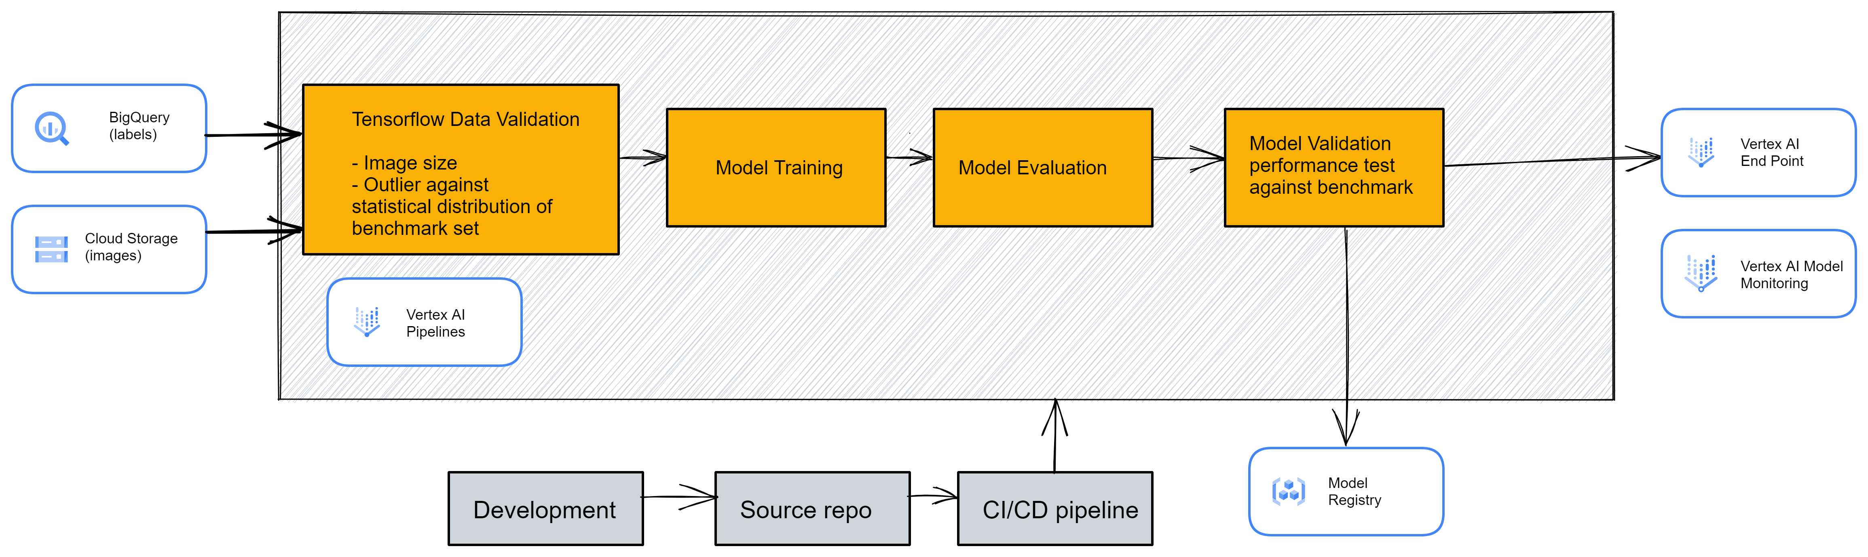
High-Level Architecture

